Slide 1
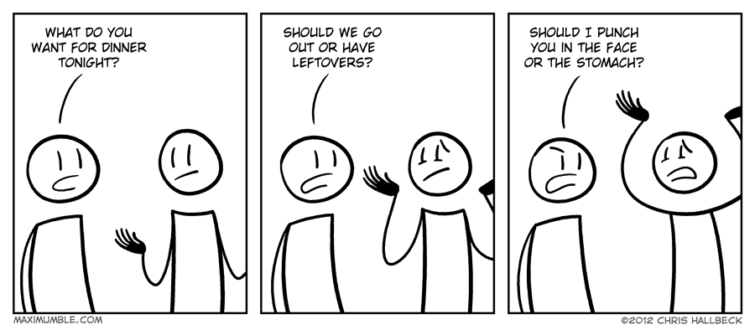
Hungry and indecisive
John, Justin and Rob
May 4th, 2019

Slide 2
Minimum viable product
After 60 commits we have achieved our MVP.
Our user is able to:
Avoid drama associated with indecision about choosing dinner
Each partner has an equal chance of getting their chosen cuisine
Restaurants are selected based on proximity to user current location
Restaurants are taken out of future selections if they have already been visited or if they are blacklisted by the user (slime in the ice machine, rats, etc)
Get current map to the restaurant.
Next version will include a minimum rating, a maximum distance from current location and some flashier design!

Slide 3
Technology used
GitHub
HTML
CSS
JavaScript
Bootstrap
JQuery
Firebase
mapbox

Slide 4
Zomato api fun
Many ways of calling same data and not all functional or documented well!
Eventually decided on one call to API up front (actually 6 calls due to pull limit) and then we can use this object over and over to get data we need.
Getting cuisines out of object – some restaurants have multiple
Forcing equal chances if popular cuisine is shown versus less popular
Selecting winner and displaying modal

Slide 5
Firebase fun
Used to store previous restaurants visited and blacklist
Visited and blacklisted used to limit selections of available restaurants by cuisine
Issues with asynchronous calls – ended up storing whole array of objects as a single JSON string

Slide 6
Holy Git
Lessons learned – start a new branch, every time
Stashing is my friend
Security settings on master are not needed to achieve MVP…next time

